Slide 1


CARELIGHT
Anytime -Anywhere

Slide 2

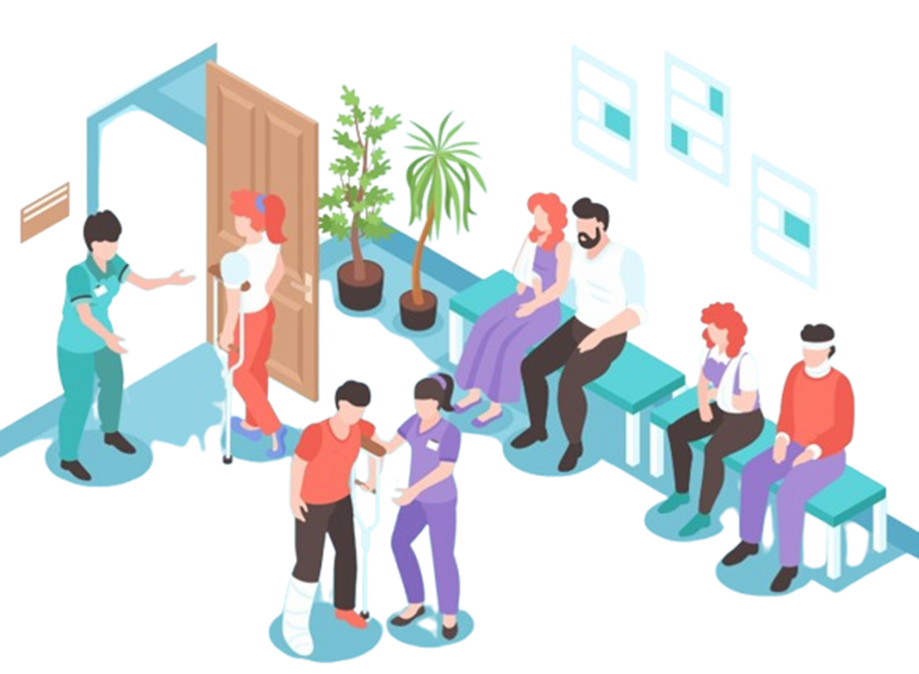
Has Reaching a Doctor Become a Difficult Task?
CARELIGHT
Anytime -Anywhere

Slide 3

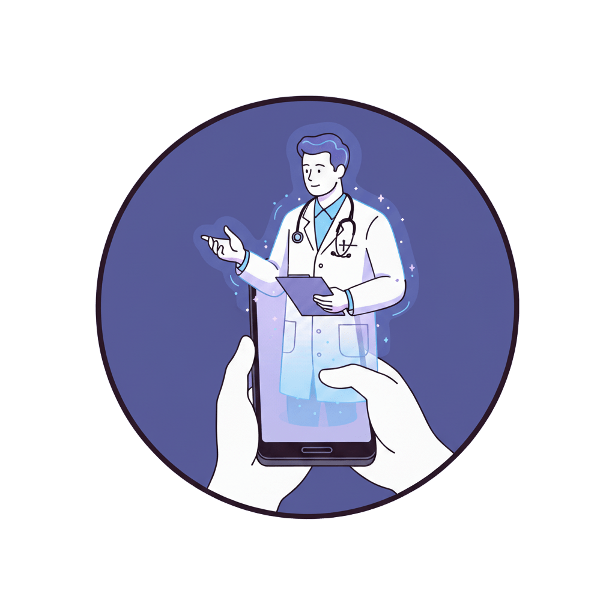

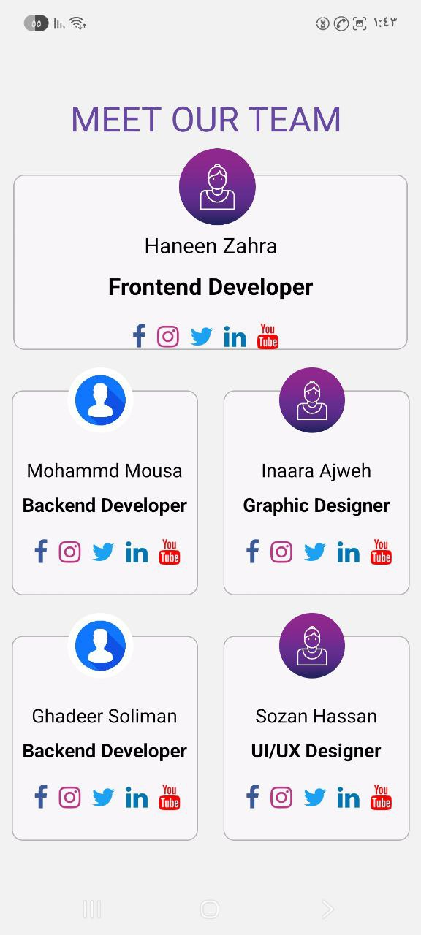
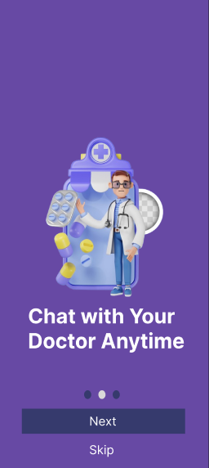
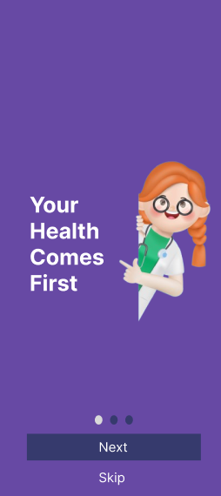
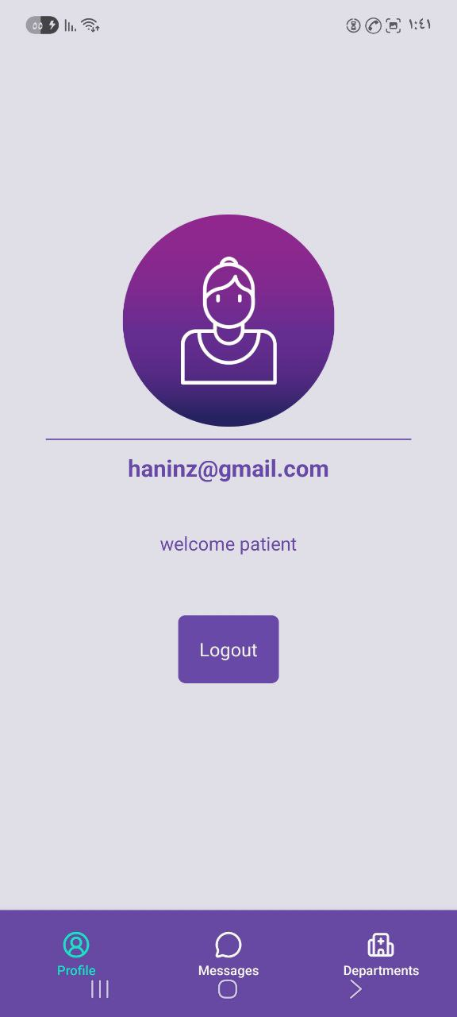
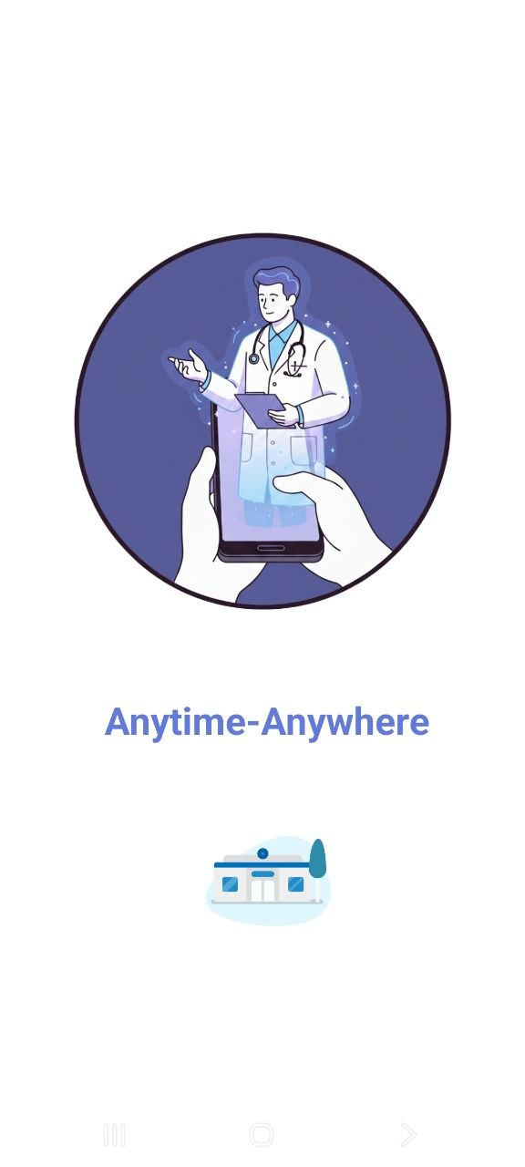
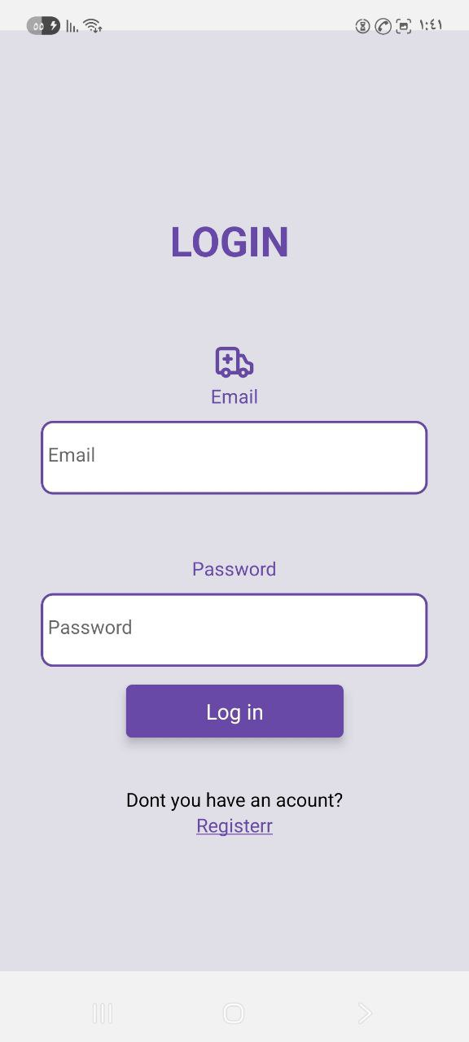
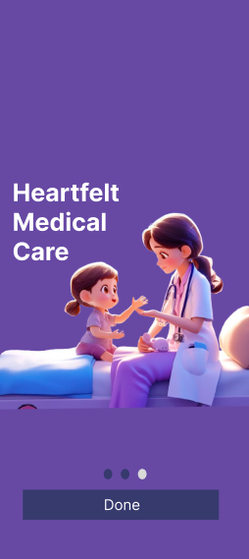
One click to solve.
One click to solve
One app makes finding the right
doctor easier than ever
Choose
Compare
Connect
01.
Remote access
02.
03.
Patient-first approach
Compassionate care

Slide 4


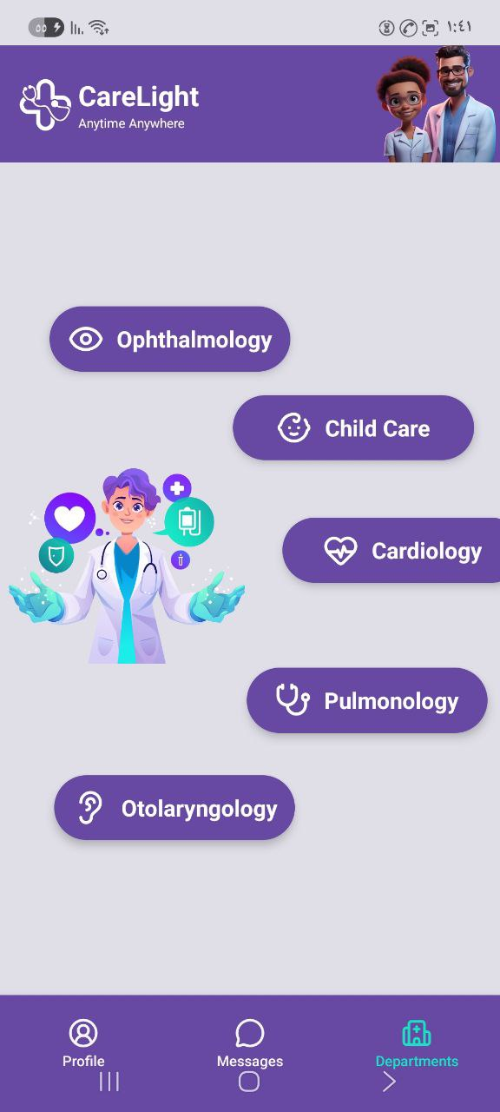

One click to solve
One app makes finding the right
doctor easier than ever
Start your journey
with Us

Slide 5

Start your journey
with Us

Slide 6
Start your journey
with Us

Slide 7
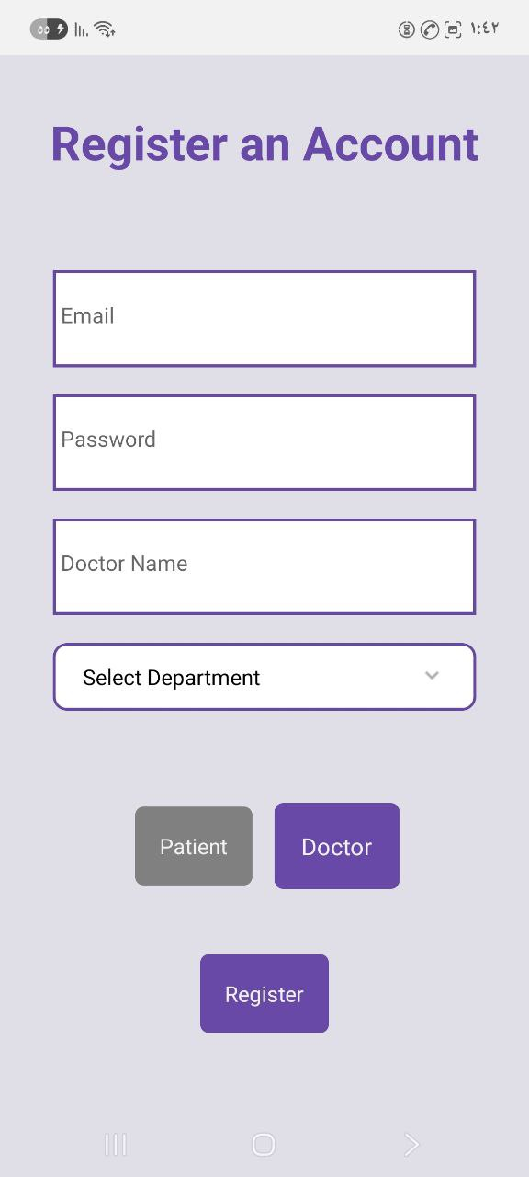
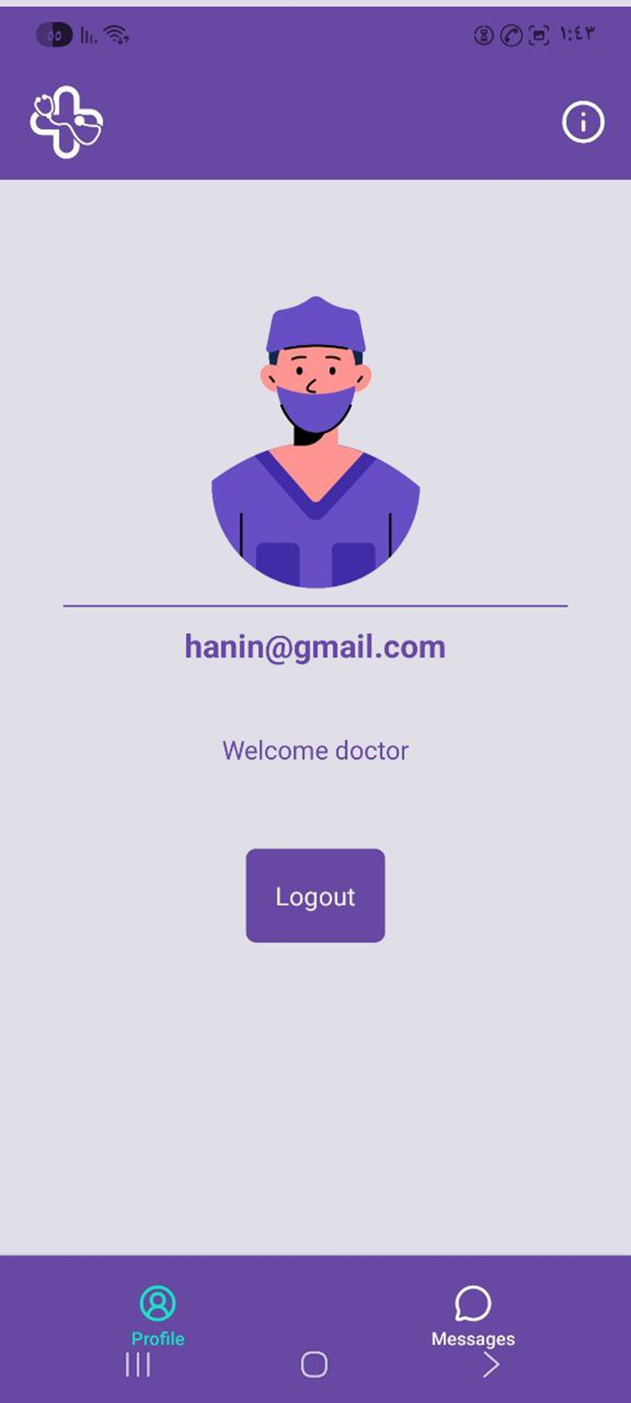
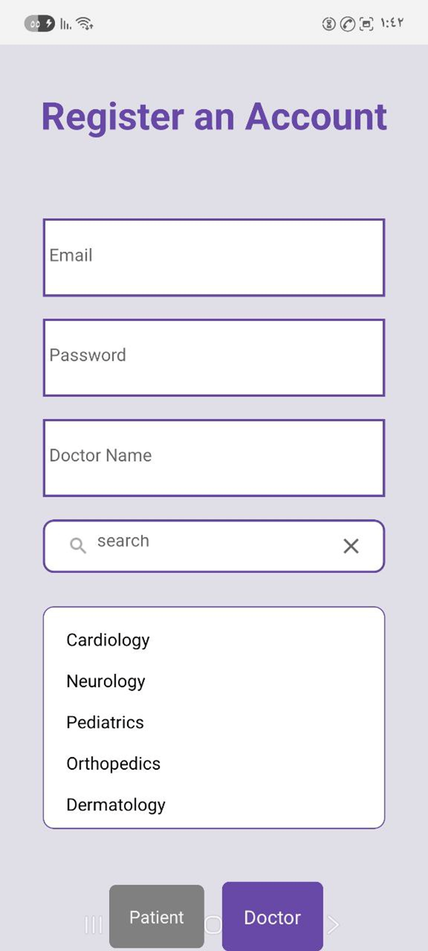
Start your journey
with Us

Slide 8

Log in
For doctor

Slide 9
Log in
For doctor

Slide 10
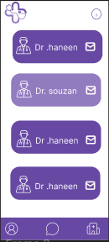
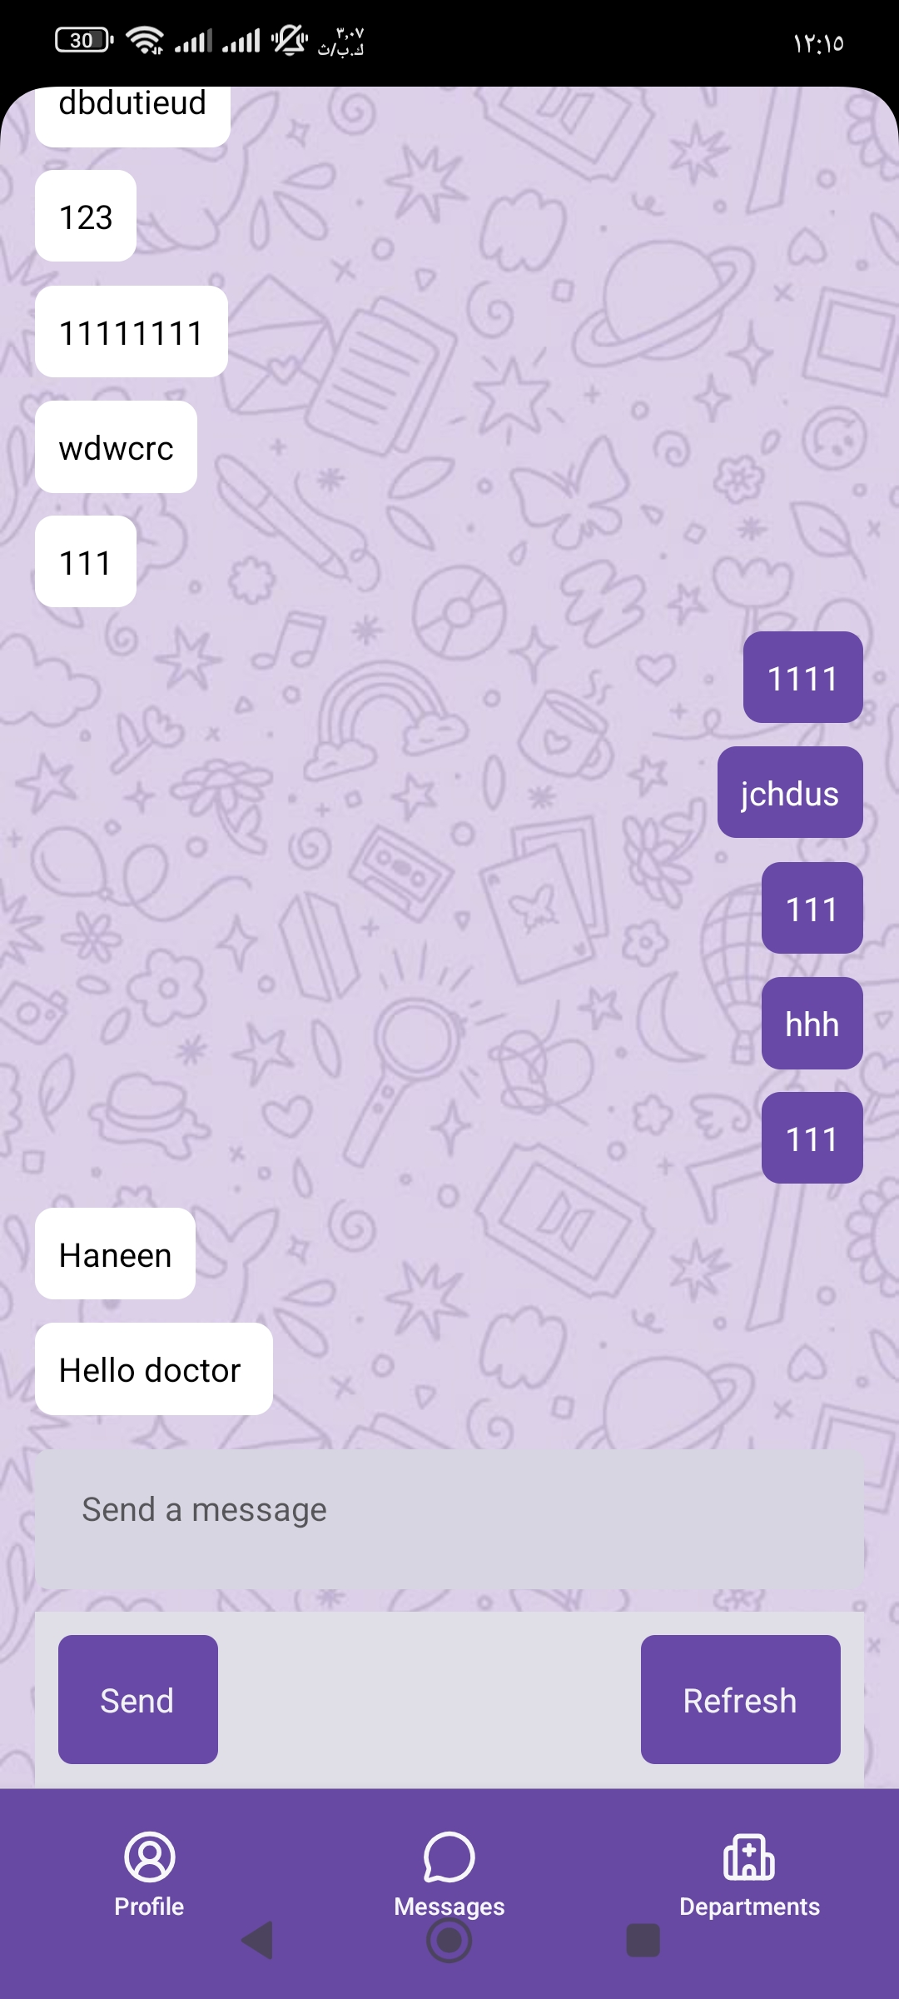
Log in
For doctor

Slide 11

Why you have to chose our app?

Slide 12
Why you have to chose our app?

Slide 13
Why you have to chose our app?

Slide 14

Why you have to chose our app?
REVENUE MODEL
ADS in the app
Percentage for doctors
Monthly subscription

Slide 15







Who’s Behind the Code ?

Slide 16

THANK YOU

